Slide 1
Pacific Climate Finance Marguerite Harden SPREP July 24, 2015

Slide 2
Agenda
Climate Finance Challenges
Overview of Climate Finance in the Pacific
Next Steps: What I’m Handing Off

Slide 3
Agenda
Climate Finance Challenges
Overview of Climate Finance in the Pacific
Next Steps: What I’m Handing Off

Slide 4
Climate Finance Challenges
Defining “Climate Finance”
Fuzzy Boundaries
Non-Standard Data

Slide 5
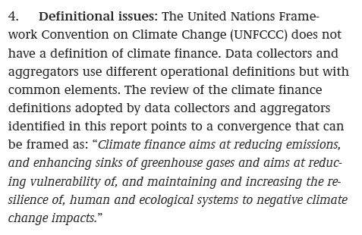
Challenge #1: Defining Climate Finance
Source: UNFCCC, 2015

Slide 6
Two Major Types of Climate Finance
Climate Finance
1.
Public and Private Finance to address CC globally
2.
Flows from developed to developing countries aimed at addressing climate change

Slide 7
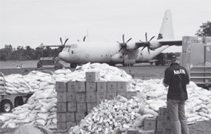
Challenge #2: Fuzzy Boundaries
“Climate finance is really ODA with a climate flavor.”
-Simon Wilson
(Smart Climate Finance WG Member)

Slide 8
Challenge #3: Data Collection
 | Pacific Climate Change Portal (PCCP) | Climate Finance Update (CFU) | Organization for Economic Cooperation and Development (OECD)
Regions | 14 PSIDS / SPREP Member Countries | “Asia and the Pacific” +Timor Leste | “Oceania” (+Tokelau +Wallis-Futuna = .5%)
Sectors | None | OECD Sector Classification | OECD Sector Classification
Climate Change Objective | PIFACC Themes | Adaptation, Mitigation, REDD | Adaptation, Mitigation
Project Budget | Total project budget (including co-financing) | Amount approved from aid organization | Amount approved from aid organization; % that is climate related
Tracking Method | Project-by-project | Fund-by-Fund (24 different funds, mostly multilateral) | Reporting required by UN, which includes a % of “Core Funding”
Time Period | 2002-2013 | 2002-2013 | 2013 (complete data)

Slide 9
How does the PCCP compare?
 | Pacific Climate Change Portal (PCCP) | Climate Finance Update (CFU) | Organization for Economic Cooperation and Development (OECD)
Amount of Pacific Climate Finance Approved in 2013 | $96 M | $74 M | $474 M
5 x’s greater!
Guess how much climate finance OECD announced in 2013!!!
Notes:
I/Cilla added $200M worth of projects into the Portal

Slide 10
How does the Pacific compare globally?
 | Pacific Climate Change Portal (PCCP) | Climate Finance Update (CFU) | Organization for Economic Cooperation and Development (OECD)
Amount of Pacific Climate Finance Approved in 2013 | $96 M | $74 M | $474 M
Amount of Global Climate Finance Approved in 2013 |  |  | $38.5 B

Slide 11
Global Climate (Development) Finance
Average $/Capita (Global, Developing):*
$7
2013
N = $38.5 Billion USD
*Based on global developing country population in 2013: 5.9 B Source: PBS, 2015
OECD, 2013

Slide 12
Agenda
Climate Finance Challenges
Overview of Climate Finance in the Pacific
Next Steps: What I’m Handing Off

Slide 13
Overview of Climate Finance in the Pacific
Where have Pacific climate funds come from?
Where have climate funds gone in the Pacific?
What has been funded in the Pacific?
How are climate funds structured in the Pacific?
What are current trends in climate finance in the Pacific?
How does climate finance in the Pacific compare to global trends?

Slide 14
Overview of Climate Finance in the Pacific
Where have Pacific climate funds come from?
Where have climate funds gone in the Pacific?
What has been funded in the Pacific?
How are climate funds structured in the Pacific?
What are current trends in climate finance in the Pacific?
How does climate finance in the Pacific compare to global trends?

Slide 15
Climate Finance Flows
Bilateral
Multilateral
Recipients

Slide 16
Donor Directory

Slide 17
Donor Directory
Database
+ 4
+ 10

Slide 18
…Where have Pacific climate funds come from?
N = $737.8 M USD
PCCP, 2002-2013

Slide 19
70%
Average Project: $1.2 M
30%
Average Project:
$2.8 M
OECD, 2013

Slide 20
OECD, 2013

Slide 21
Overview of Climate Finance in the Pacific
Where are Pacific climate funds coming from?
Where have climate funds gone in the Pacific?
What has been funded in the Pacific?
How are climate funds structured in the Pacific?
What are current trends in climate finance in the Pacific?
How does climate finance in the Pacific compare to global trends?

Slide 22
¼ of funds go toward regional projects
11 of 14 islands receive <10% of funds
N = $737.8 Million USD
PCCP, 2002-2013

Slide 23
Top 10 Recipient Countries of Climate Finance
PCCP, 2002-2013

Slide 24
Overview of Climate Finance in the Pacific
Where are Pacific climate funds coming from?
Where have climate funds gone in the Pacific?
What has been funded in the Pacific?
How are climate funds structured in the Pacific?
What are current trends in climate finance in the Pacific?
How does climate finance in the Pacific compare to global trends?

Slide 25
What is being funded?
PCCP, 2002-2013
OECD, 2013

Slide 26
Overview of Climate Finance in the Pacific
Where are Pacific climate funds coming from?
Where have climate funds gone in the Pacific?
What has been funded in the Pacific?
How are climate funds structured in the Pacific?
What are current trends in climate finance in the Pacific?
How does climate finance in the Pacific compare to global trends?

Slide 27
Grants:
Budget Range | # of Projects | % of Total
< $1M | 61 | 44%
$1 M - $2.99 M | 25 | 18%
$3 M - $4.99 M | 15 | 12%
$5 M - $9.9 M | 20 | 14%
$10 M - $24 M | 14 | 10%
$25 M - $49 M | 2 | 1%
$50 M or more | 2 | 1%
PCCP, 2002-2013

Slide 28
Overview of Climate Finance in the Pacific
Where are Pacific climate funds coming from?
Where have climate funds gone in the Pacific?
What has been funded in the Pacific?
How are climate funds structured in the Pacific?
What are current trends in climate finance in the Pacific?
How does climate finance in the Pacific compare to global trends?

Slide 29
Pacific Climate Change Projects & Funding Over Time
PCCP, 2002-2013

Slide 30
Overview of Climate Finance in the Pacific
Where are Pacific climate funds coming from?
Where have climate funds gone in the Pacific?
What has been funded in the Pacific?
What are current trends in climate finance in the Pacific?
How are climate funds structured in the Pacific?
How does climate finance in the Pacific compare globally?

Slide 31
Where are funds coming from?
Pacific
Globally
60%
Average Project: $3.4 M
70%
Average Project: $1.2 M
40%
Average Project:
$13.9 M
30%
Average Project:
$2.8 M
OECD, 2013

Slide 32
Climate Finance Per Capita
Average $/Pacific Islander:
$77
Remember…
Average $/Capita (Global, Developing):
$7
PCCP, 2002-2013

Slide 33
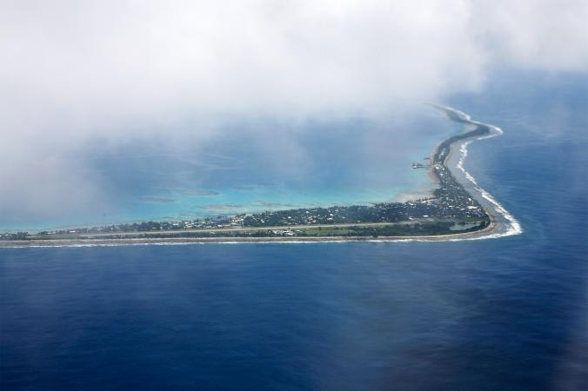
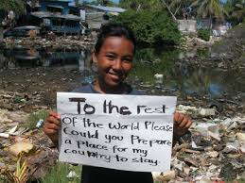
Tuvaluan:
$1,577 USD
in climate finance
2013 GDP/capita = $3,861 USD
Average household size = 6 (source)
$9,462 USD/Household
Image Source: National Geographic

Slide 34
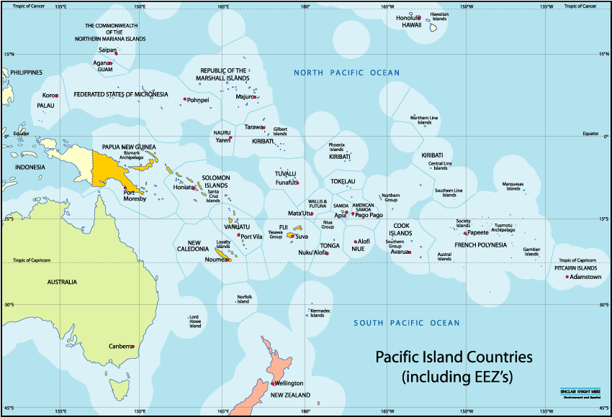
Climate Finance Per Land & Sea Area
Image Source: SPC
Notes:
Exclusive Economic Zone

Slide 35
Climate Finance Per Land & Sea Area
Average $/km²:
$38
PCCP, 2002-2013

Slide 36
Overview of Climate Finance in the Pacific
Where are Pacific climate funds coming from?
Where have climate funds gone in the Pacific?
What has been funded in the Pacific?
What are current trends in climate finance in the Pacific?
How are climate funds structured in the Pacific?
How does climate finance in the Pacific compare globally?
What’s missing?

Slide 37
What’s Missing?
A Third Dimension: Impact
Private Sector
Philanthropy
Private Sector

Slide 38
Agenda
Climate Finance Challenges
Overview of Climate Finance in the Pacific
Next Steps: What I’m Handing Off

Slide 39
Next Steps: What I’m Handing Off
Donor Database
Climate Finance Flows Architecture
PCCP Projects Database Additions
Pacific Climate Finance Report, Data
Pacific Climate Finance Briefing (2 Page) …Memo on Private Finance for the Pacific

Slide 40
Faafetai Lava!
SPREP
SPREP Climate Change Division
Steve Newman, BioDiversity International
Climate Funds Update
Posa & Pualele

