Slide 1

Inform Project
Notes:
Check who knows about Inform project?
Intro on State of Environment (SOE) reporting process and effort to collect data.
Regular reporting / multiple reporting requirements.
But where does all the environmental data go? Sits on personal laptops, not shared,…
Every time, for every report, in most cases, you have to start all over again.

Slide 2



Notes:
This is a 1-minute video on the Inform Project.

Slide 3
Environmental data management
- A national and regional challenge -
Inform project
All 14 Pacific Island Countries have data storage management and use issues
This became clear through the SOE process and others
SPREP developed a project to address this, called “Inform”

Slide 4
Inform title
Building National and Regional Capacity to Implement Multilateral Environmental Agreements by Strengthening Planning and the State of Environmental Assessment and Reporting in the Pacific
Referred to as the Inform project
Notes:
Complete official title of the Inform Project.
Background in ecology, forestry, marine conservation became more concerned about how non-sector issues effect the env sector.
Ag, fishing, urban development waste water …

Slide 5
Project Name | Building National and Regional Capacity to Implement Multilateral Environmental Agreements by Strengthening Planning and the State of Environmental Assessment and Reporting in the Pacific Referred to as the Inform project
Objective | National Reporting System that stores data and/or connects to existing databases. Improvements in monitoring and reporting. Improvement of capacity of Pacific Island Countries (PICs).
Summary | Establish a Pacific Island Country network of national and regional databases for monitoring, evaluating, and analysing environmental information to support environmental planning, forecasting, and reporting requirements at all levels.
Project funding | $4,319,635 GEF grant, including co-financing from PICs @200,000 each
Geographical scope | Regional Multi-Country: Cook Islands, Federated States of Micronesia, Fiji, Kiribati, Republic of the Marshall Islands, Nauru, PNG, Palau, Papua New Guinea, Samoa, Solomon Islands, Tonga, Tuvalu, and Vanuatu
Duration | Four years, starting January 2017
Notes:
Delivery modality – SPREP

Slide 6

Inform goal
Environmental data used for decision making
Notes:
Or any data -

Slide 7
History
NCSA – National Capacity Self-Assessment
  Issues gathering and using environmental data recognized as a regional issue
  MEAs recognize the reporting obligations can be a burden
  MDGs had 60 indicators – SDGs 242
  SPREP/EMG team has documented the challenge – recent experience with SOEs/NEMS
  Many here recognize it form the standard requirement for a “desktop review “ for every project
Notes:
GEF project: The objective of this project is to identify capacity gap and to develop action plan to strengthen the capacity of stakeholders at all levels such that the established policies, strategies and plans that facilitate implementation of obligations under the three Conventions are fully and effectively enforced”.

Slide 8
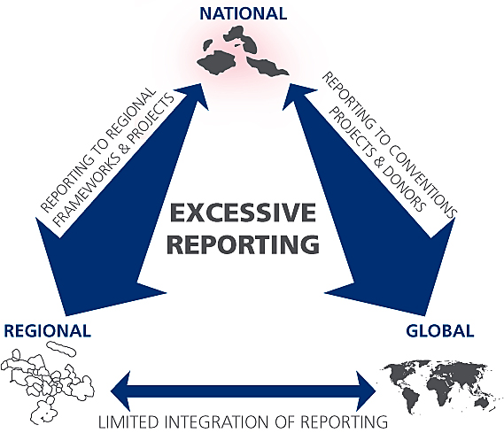
Notes:
This leads to an excessive reporting burden – one part of the solution to address this is the SOE- which can reduce the need to re analyse and find data

Slide 9
Response
SPREP members, developed this project in response – to address the systemic issue of environmental data management and use.
Data management
Data analysis
Multiple reporting obligations/needs
(MDGs: 60 indicators – SDGs: 242 indicators)
4. Shift in business practices

Slide 10
Implementation modality
GEF funded
UN Environment implemented
SPREP executed
Country process and outputs enhanced

Slide 11
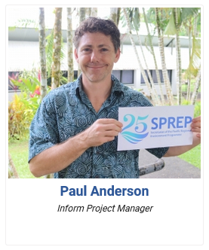
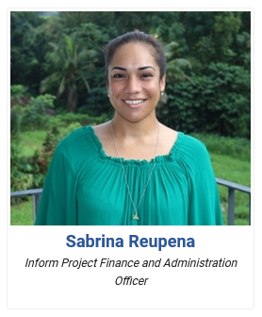
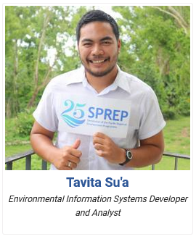
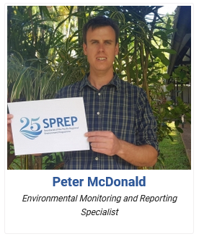
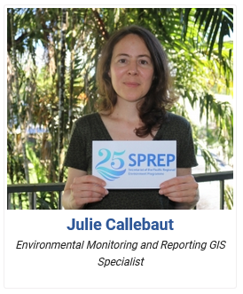
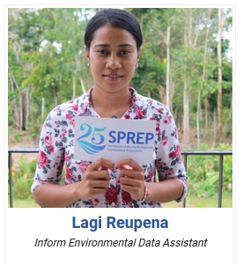
The Inform team
paula@sprep.org
sabrinar@sprep.org
tavitas@sprep.org
petermc@sprep.org
juliec@sprep.org
lagir@sprep.org

Slide 12
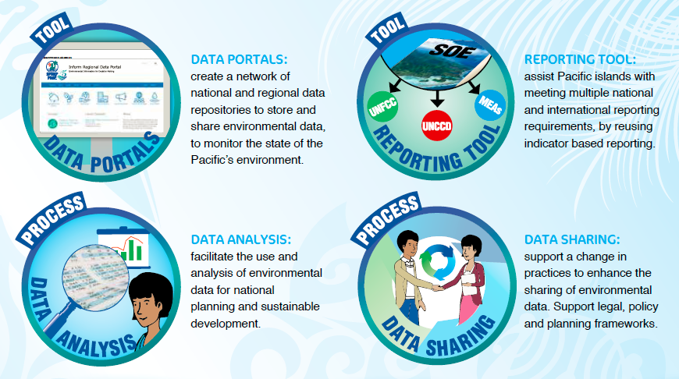
The Inform Project
Notes:
Inform has 4 products.
The data portal – ENV data management
The analysis- Indicators (SOE or other)
The reporting tool (built to reuse indicators for overlapping reporting requirements
Capacity building, improved processes, including data access and use – Change in practices
We are going to discuss some of the tools that have been developed to foster these changes – but the important point to remember is the tool are only a means to an end- to make efforts more effective and meaningful

Slide 13
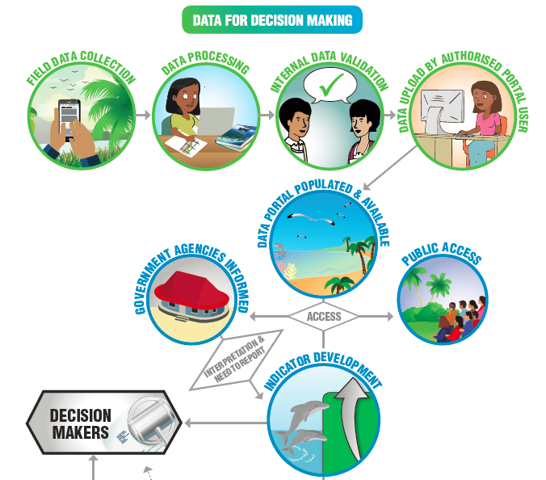

Slide 14
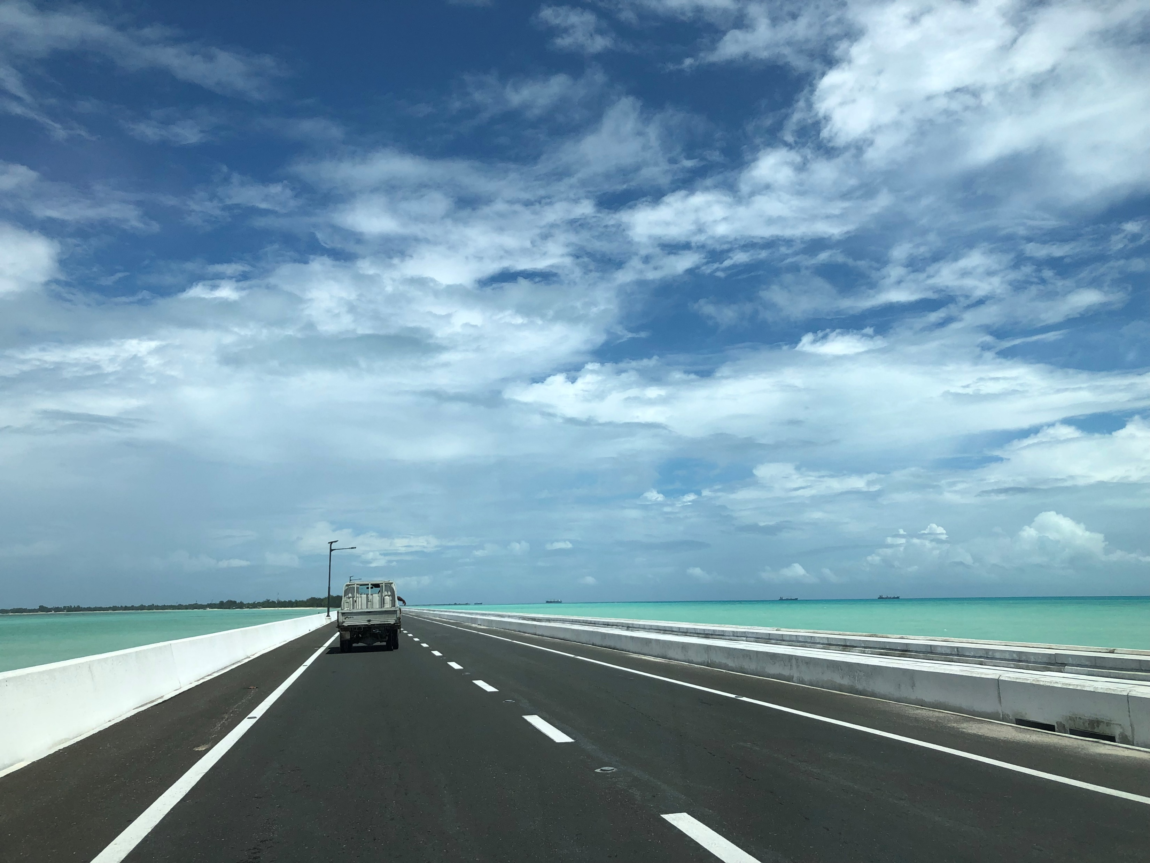
What is a data portal?

Slide 15



Data Portal
Repository where data is stored (online database)
Backups
Sharing data on different levels (public/shared/private)
Collaborate within Groups (departments / agencies)
Publishing platform
Open source tools: DKAN Open Data Platform (https://getdkan.org/)
Cloud or in-country hosting
Other Examples:
Data.gov
Data.gov.uk
Data.gov.au
Data.gov.nz
Data.europa.eu
Etc...

Slide 16


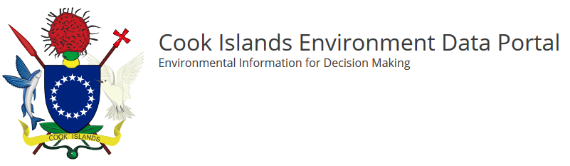

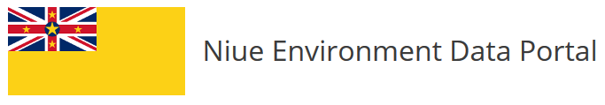



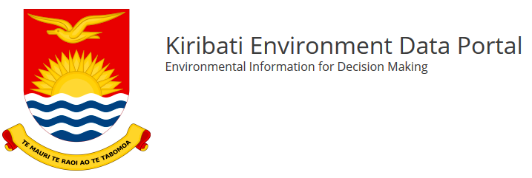



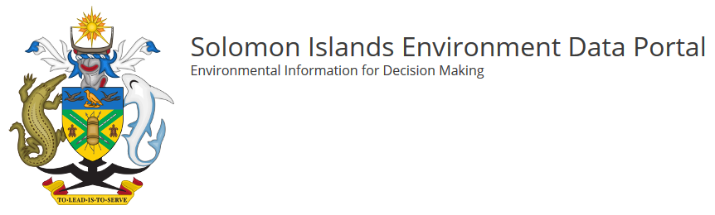
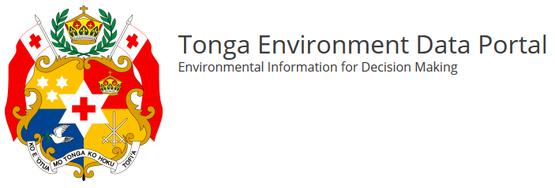
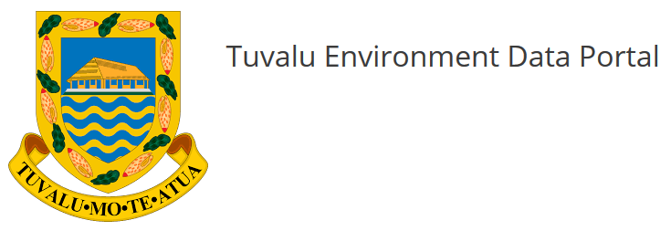
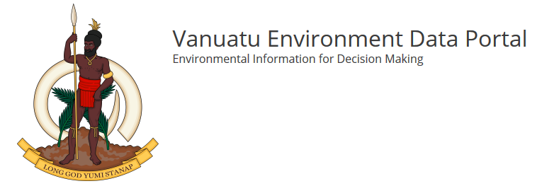
1 Regional Portal
14 National Portals
Notes:
1 Regional data portal = The Pacific Environment Portal (managed by SPREP)
14 National data portals, managed by the countries: 1) Cook Islands, 2) Papua New Guinea, 3) Niue, 4) FSM, 5) RMI, 6) Fiji, 7) Kiribati, 8) Nauru, 9) Palau, 10) Samoa
11) Solomon Islands, 12) Tonga, 13) Tuvalu, and 14) Vanuatu

Slide 17
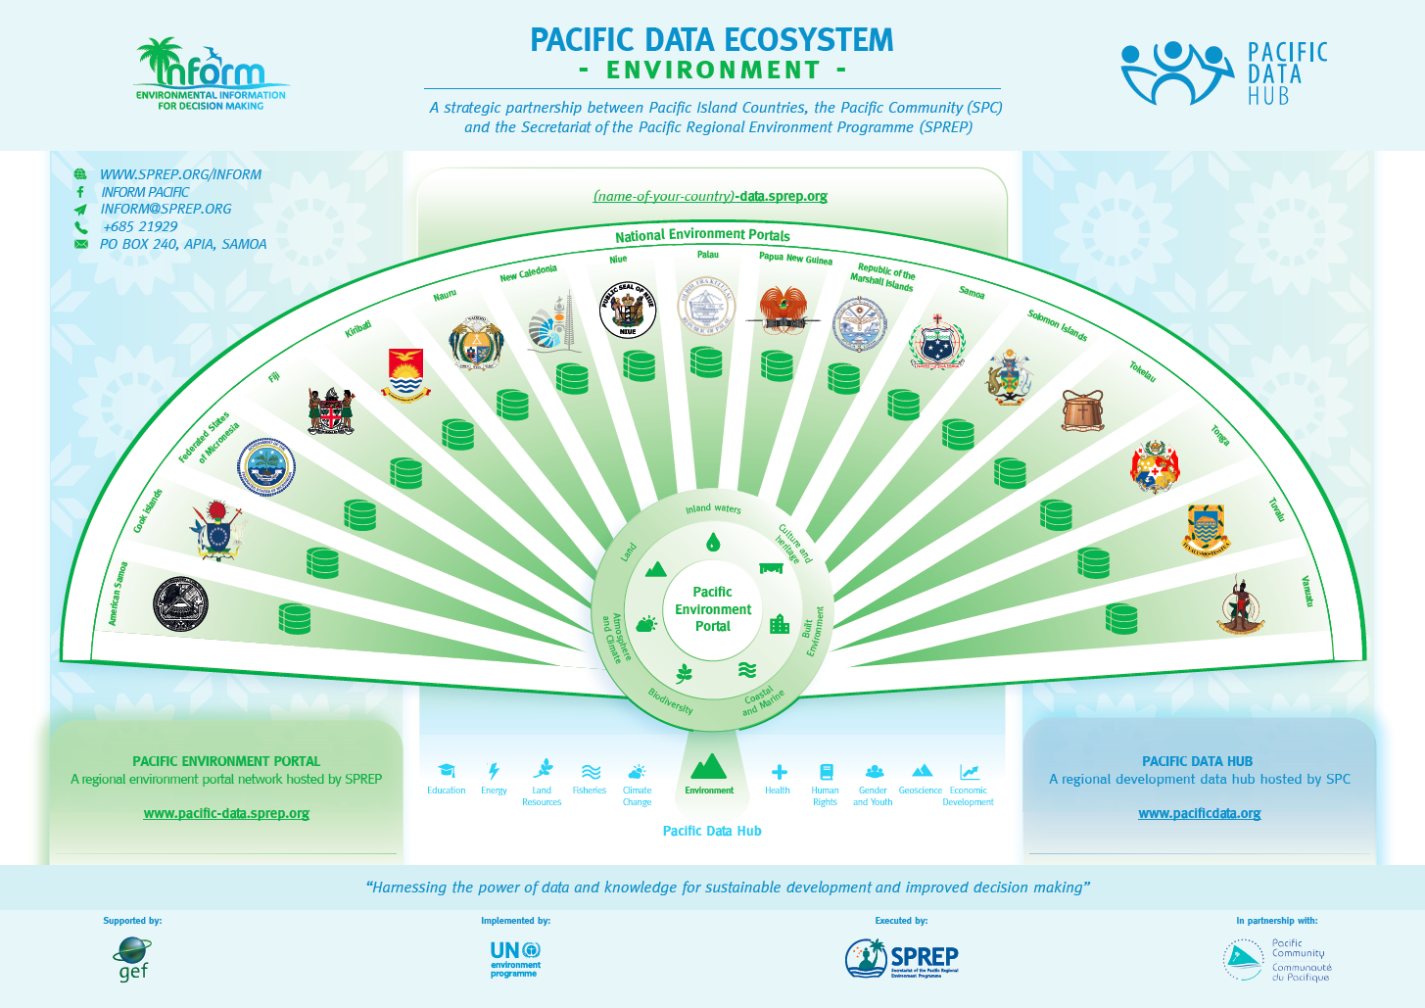
Notes:
All the National Environment Portals are part of the Pacific Data Ecosystem, a partnership between Pacific Island Countries, SPREP and SPC.
All data of the National Environment Portals comes together in the Pacific Environment Portal (= the regional environment portal).
This Pacific Environment Portal is also connected to the Pacific Data Hub from SPC.

Slide 18
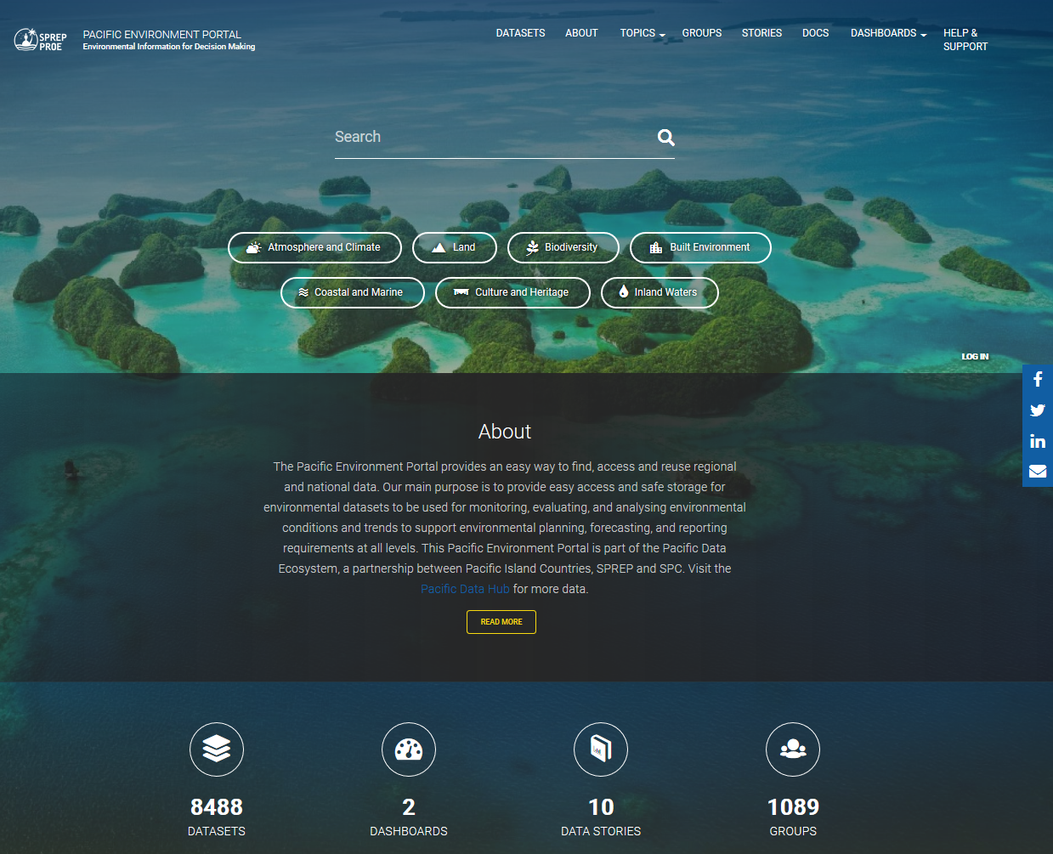
Pacific Environment Portal
https://pacific-data.sprep.org/

Slide 19
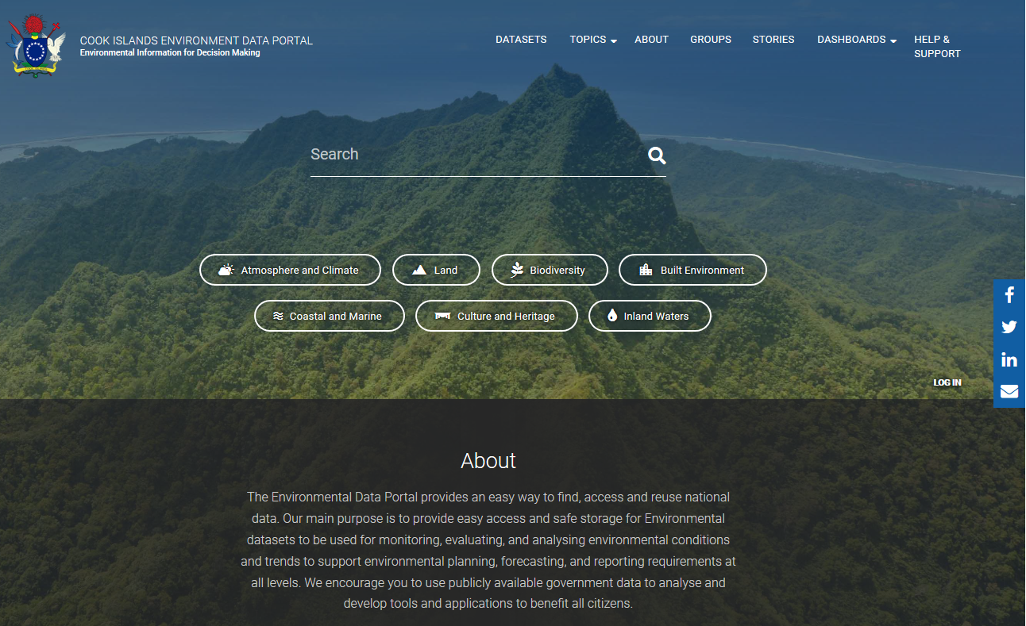
Cook Islands Data Portal
https://cookislands-data.sprep.org/

Slide 20
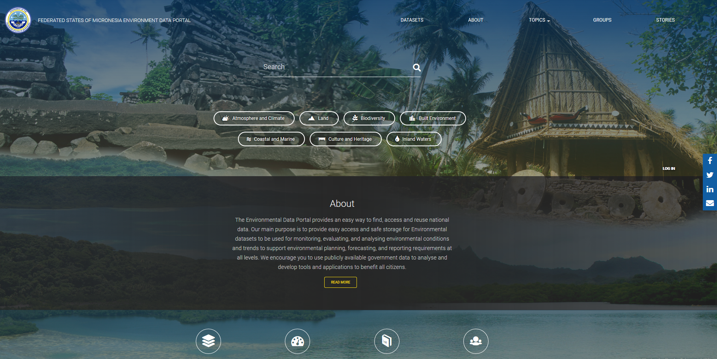
FSM Data Portal
https://fsm-data.sprep.org/

Slide 21
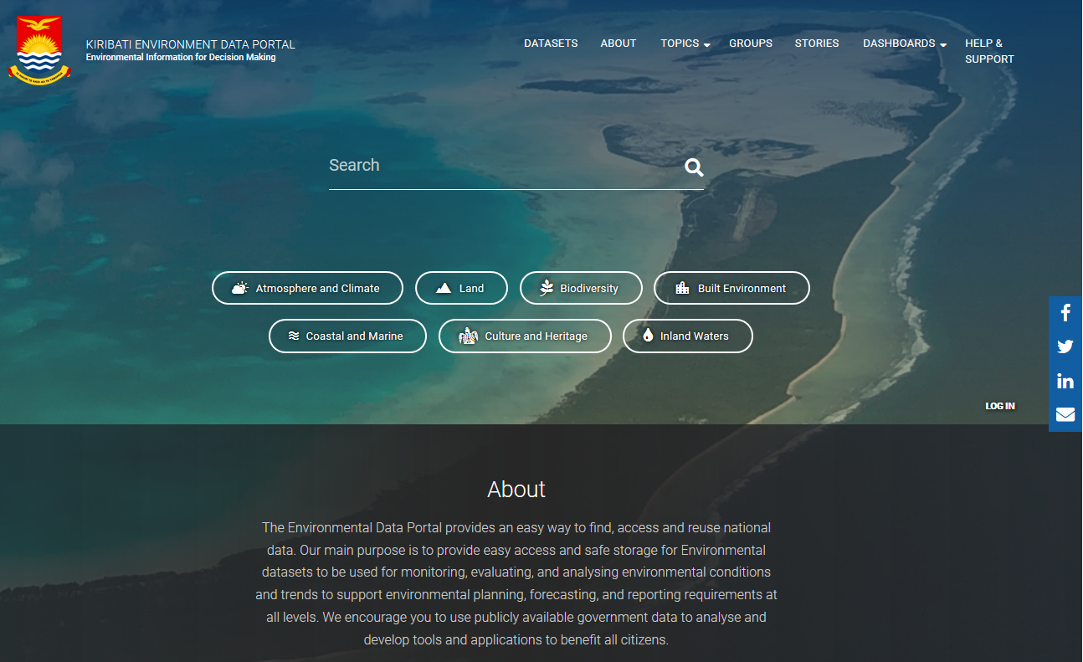
Kiribati Data Portal
https://kiribati-data.sprep.org/

Slide 22
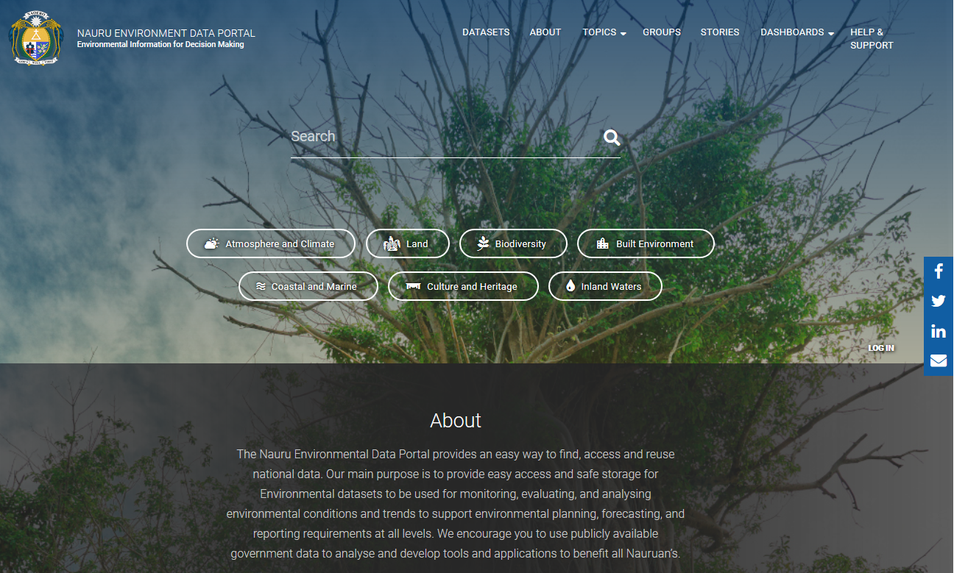
Nauru Data Portal
https://nauru-data.sprep.org/

Slide 23
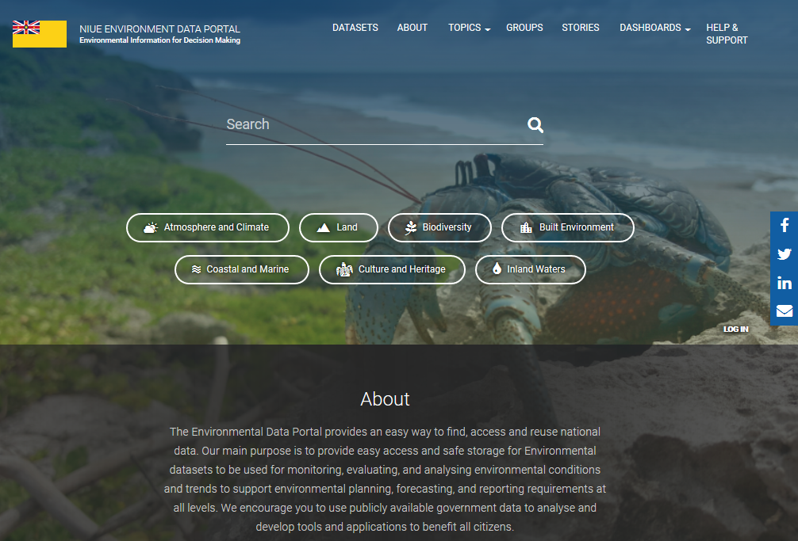
Niue Data Portal
https://niue-data.sprep.org/

Slide 24
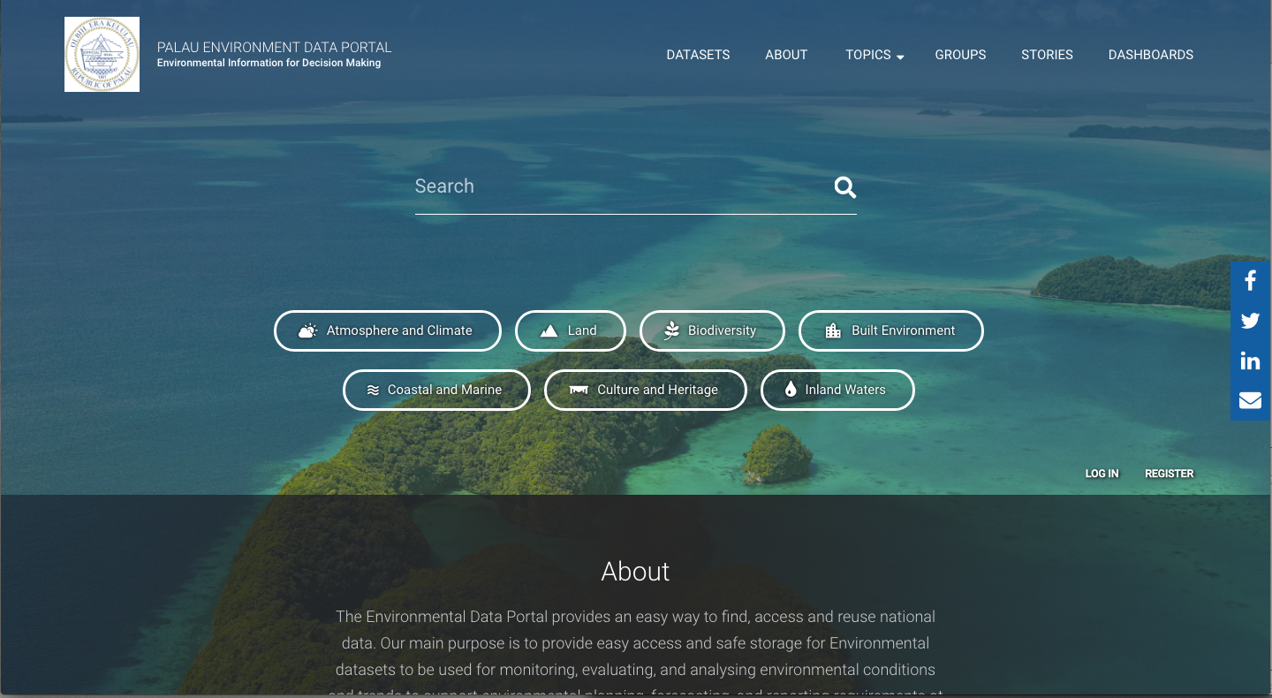
Palau Data Portal
https://palau-data.sprep.org/

Slide 25
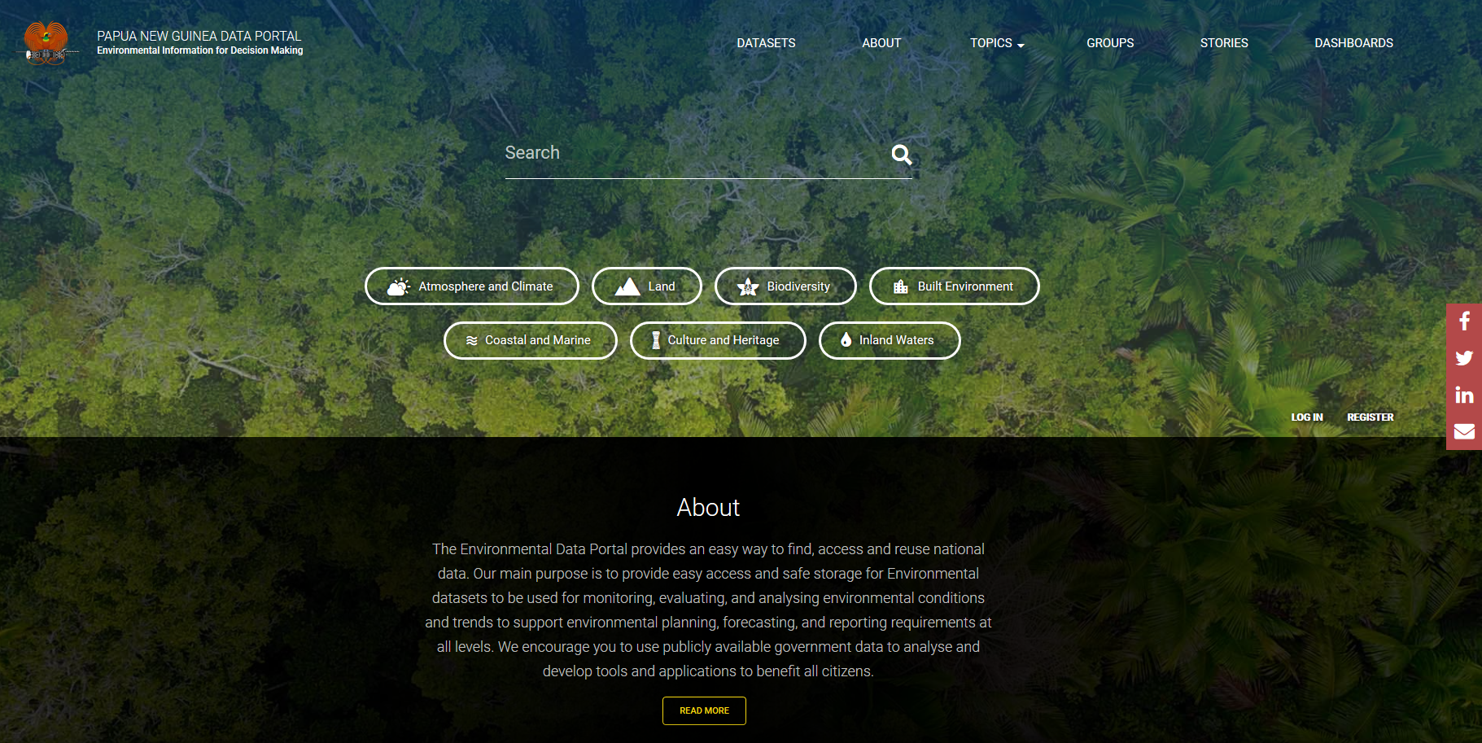
Papua New Guinea Data Portal
https://png-data.sprep.org/

Slide 26
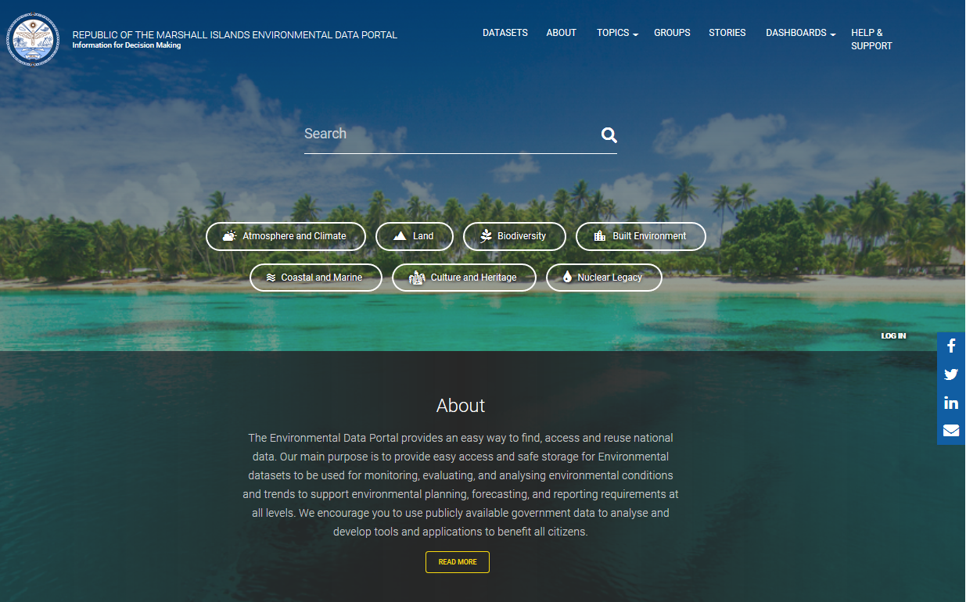
RMI Data Portal
https://rmi-data.sprep.org/

Slide 27
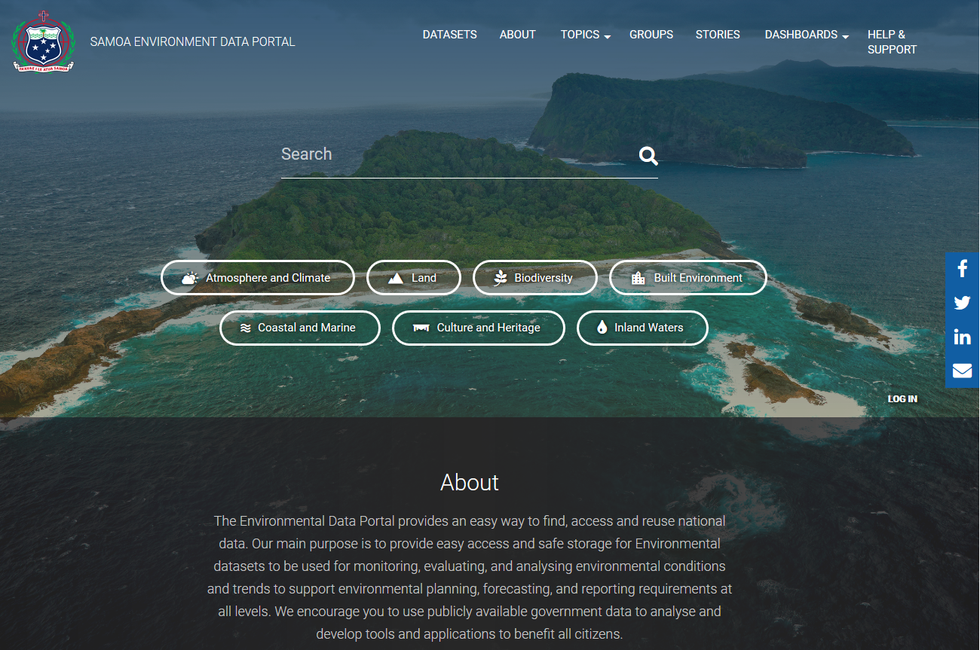
Samoa Data Portal
https://samoa-data.sprep.org/

Slide 28
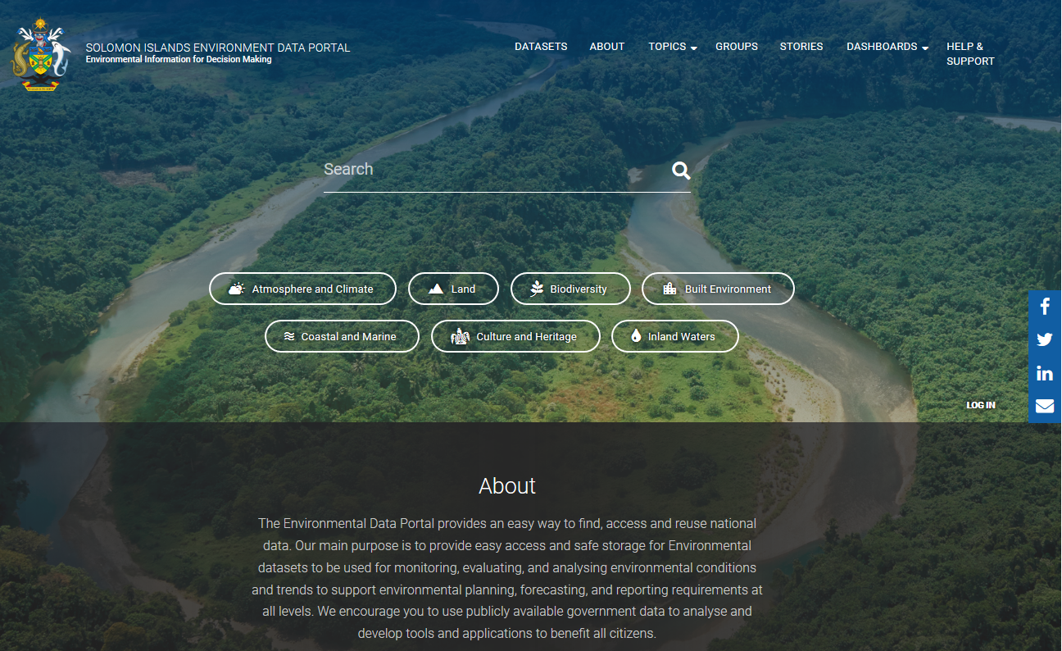
Solomon Islands Data Portal
https://solomonislands-data.sprep.org/

Slide 29
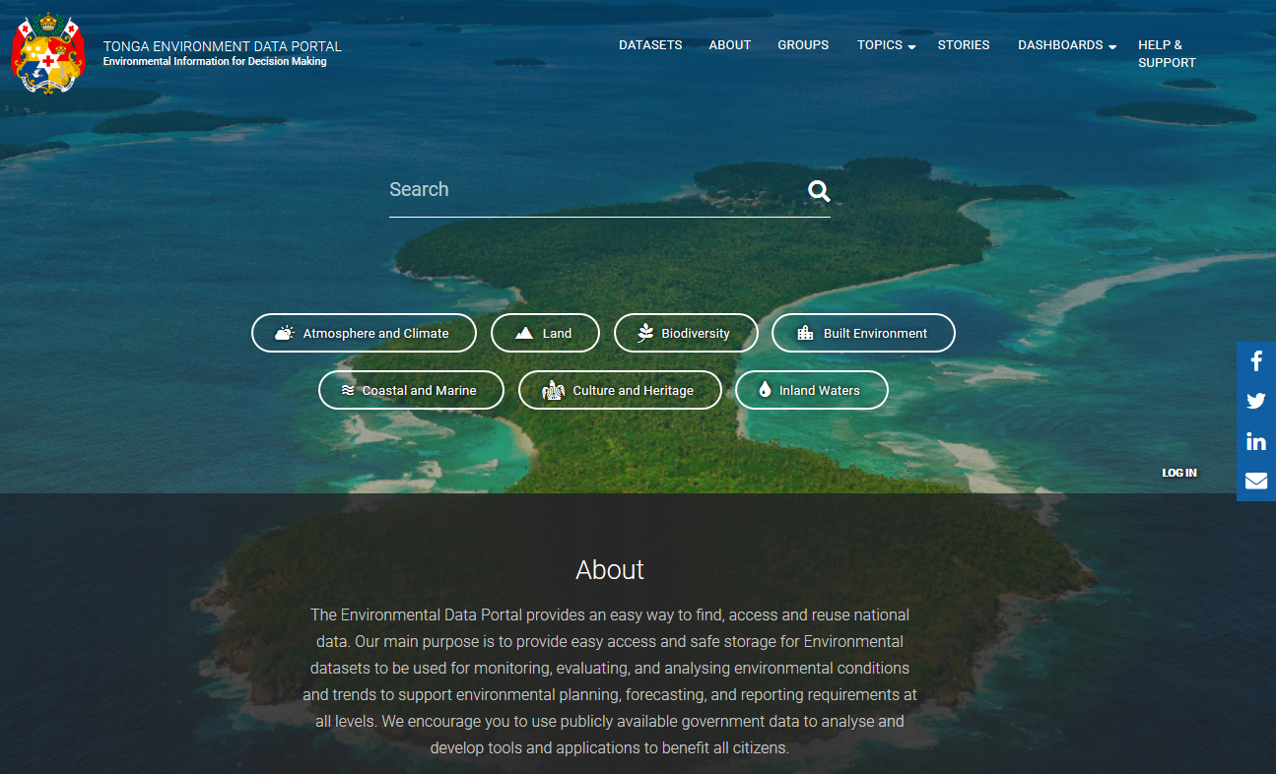
Tonga Data Portal
https://tonga-data.sprep.org/

Slide 30
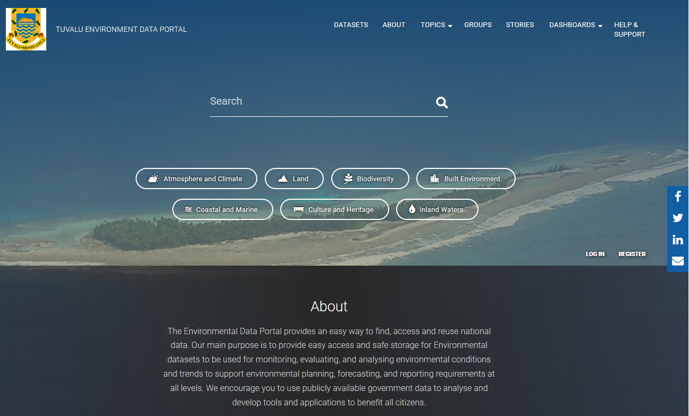
Tuvalu Data Portal
https://tuvalu-data.sprep.org/

Slide 31
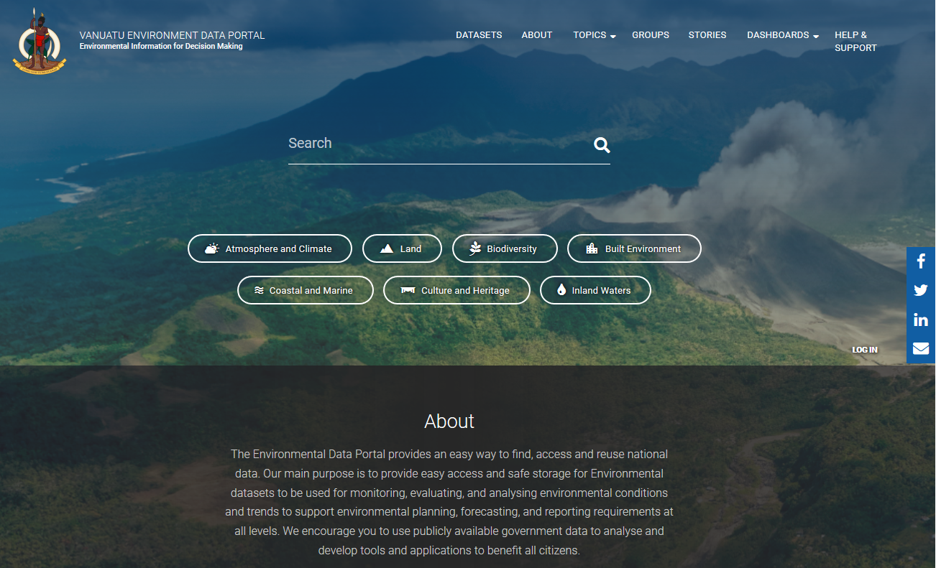
Vanuatu Data Portal
https://vanuatu-data.sprep.org/

